Slide 1

Welcome
Global health
Session 4
Globalisation and Health
Dr. Tilly Paz

Slide 2

In this session you will:
Understand what globalisation is and the main forces that drives it
Understand the main arguments of two main debates of the field
Make some progress with your assessment

Slide 3
The session plan
First hour – understanding globalisation
Second hour – diving into the Trade/Aid debate
Third hour – presenting the globalisation V. nationalism
Fourth hour – essay work

Slide 4
In the first two weeks we have…
Discussed the concept of globalisation
Mentioned the ways it can affect health (the good, the bad and the ugly)
Linked it as a concept to other global health issues such as climate change, human rights, the progression of diseases (communicable and non-communicable) and the social determinants of health

Slide 5
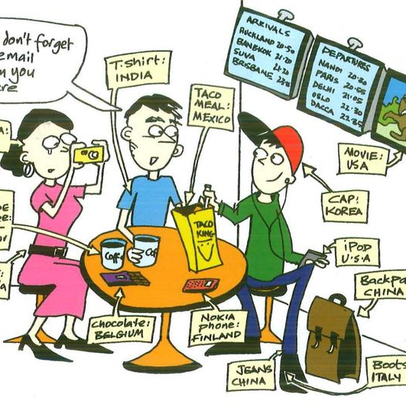
This week we will…
Go back to the smallest units created by globaliation and understand their varied and complex effects on our health and the health of others.
Leave the item that you have brough on the table, and write comments about other people’s items and their possible effects on your health and the health of others

Slide 6
Globalisation
‘The increasing interconnectedness between societies such that events in one part of the world more and more have effects on peoples and societies far away’
Baylis et al (2008)
‘a stretching of social, political and economic activities across frontiers such that events, decisions and activities in one region of the world can come to have significance for individuals and communities in distant regions of the globe’
(Held et al 1999)

Slide 7

Globalisation
The largest companies are no longer national firms, located in one single country; they are multinational corporations with businesses in many countries.
Globalisation has been taking place for hundreds of years but has rapidly increased over the last 30 years or so.
Globalisation has resulted in:
increased international trade
the same company operating in more than one country
a greater dependence on the global economy
easier movement of capital, goods and services
recognition of companies such as McDonalds and Starbucks in developing countries

Slide 8
Globalisation
Hanefeld (2015) discusses globalisation in the context of 3 dimensions of global change
Spatial
Temporal
Cognitive

Slide 9

Spatial change (space)
Changes in how we perceive physical and territorial space
Increase in population mobility
More affordable travel
More long-term migration
Movement of microbes – spread of infectious diseases
Hanefeld (2015 pp.3-5)
Notes:
Globalisation leading to changes along spatial dimensions

Slide 10

Temporal change (time)
Travel greater distances quickly through high speed air travel
Faster communications
Faster medical research
For some increased leisure time – for others increased insecurity in work in the post-industrial age
Hanefeld (2015 pp. 3-5)
Notes:
Globalisation is changing our relationship with time
Increased bureaucratisation

Slide 11

Cognitive change
Changes in what we think about ourselves and the world around us
Mass media has become global eg -Many national media outlets in different countries belonging to large transnational companies, global advertising agencies and consultancy firms
Since the 1980s convergence of modes of communication – deregulation and privatisation of the telecommunications sector
Hanefeld (2015 pp. 3-5)
Notes:
Global media landscape shapes how people access and consume news – determines their impact on how we perceive the world
Until the 1980s most media was national
– much of the news consumed
Social media sites and the ability of people to connect across the globe
More immediate and greater exchanges of people living in different continents

Slide 12

Globalisation and health
Greater movement of people and pathogens , greater knowledge exchange across physical borders leading to scientific advances, increased solidarity around health issues
In addition to the challenges to our mental, physical health and wellbeing, the social patterns of our lives have changed.

Slide 13
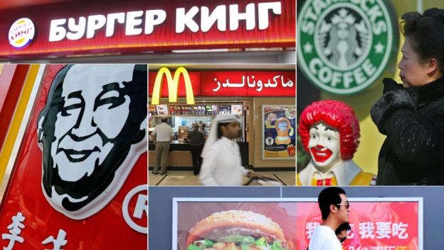
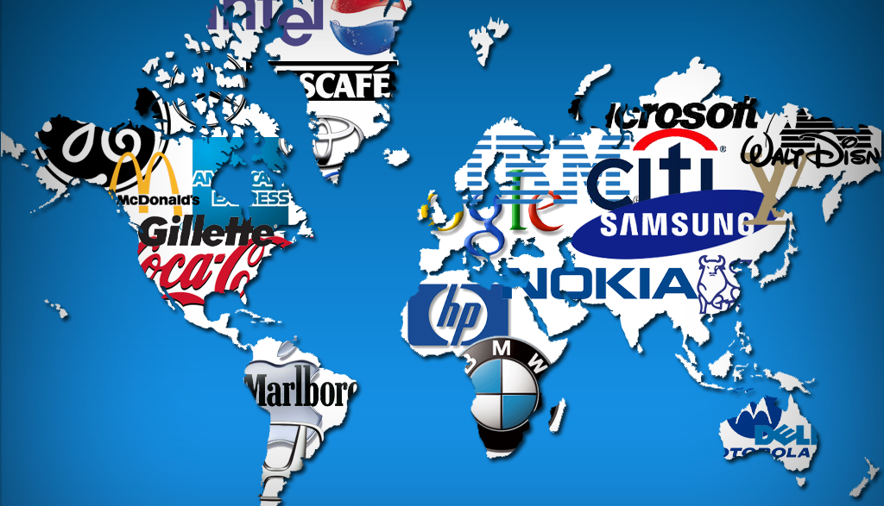
The Influence of globalisation on health
The cultural influences of globalisation and particularly western patterns of consumption have had a negative impact on health, the environment and society such as increases in; obesity, heart disease, environmental damage, global warming ,climate change and also altered family structures and decreasing health and welfare
McCracken and Phillips (2012) Jacobsen (2014)
Notes:
Changing patterns of work – altering family structures
Relocation of traditional industries to locations with cheaper costs

Slide 14

Information and transportation technology as key drivers of globalisation
Information technology has been critical to the kinds of changes associated with globalisation
Enormous leaps in technological development – exponential growth in use due to falling costs

Slide 15
What does this mean for health?
A. International transfer of health risks
Infectious diseases and international travel
Risks associated with transfer of lifestyles
Health and safety standards
B. Globalization of health care services
Movement of health providers (incl. “brain drain”)
Health tourism
Cross border establishment of facilities
C. International governance
The major players: World Trade Organisation, World Bank, International Monetary Fund, WHO

Slide 16
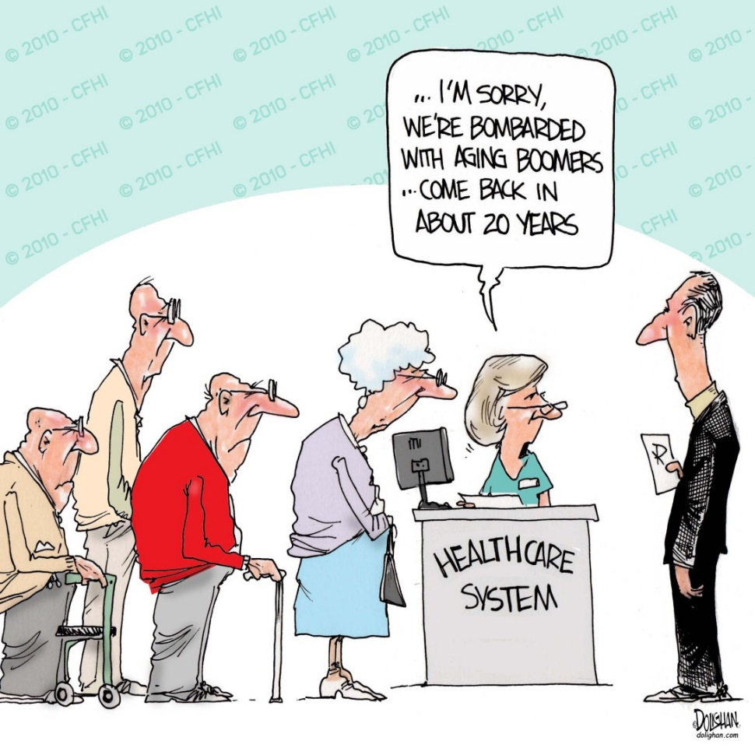
Ageing transition
The world is growing older
In many countries old people will form the majority
Massive implications for health and social care services, labour availability
Health status and health expenditure
Will people be more or less healthy as they age?
McCracken and Phillips (2012)

Slide 17
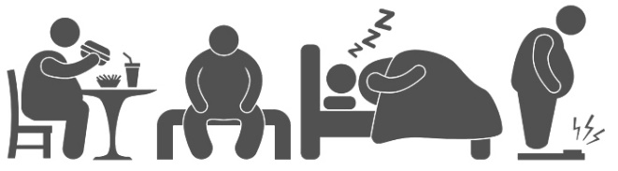
Increase in non communicable diseases
1950s-1970s chronic and degenerative conditions rapidly increasing in western developed nations
High smoking levels, high fat diets, diets rich in sugar, salt and fat and increasingly sedentary lifestyles
Cancer is now replacing heart disease as one of the leading degenerative causes of death in more recent times
McCracken and Phillips (2012)
Notes:
Rising death rates from cardiovascular diseases ( up until 1970s then improved advances in treatment of cardiovascular diseases) and stroke

Slide 18
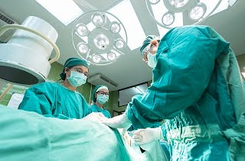
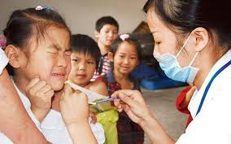
Scientific and technological advances
From 1960s onwards scientific and technological progress has improved population health making most major infectious diseases treatable /medically preventable
Infant and child survival have been greatly improved from the development of vaccines for polio, measles, mumps, rubella, chickenpox, meningitis, pneumonia .
McCracken and Phillips (2012)
Notes:
Introduction of oral rehydration therapy in 1970s, zinc supplement therapy ( since 2000) to fight diarrhoeal disease has saved millions of lives
Better nutrition, improved living standards , increased access to education and improvements in women’s rights have been essential components to improvements in medical advances

Slide 19

Debating globalisation and health
Trade
Aid
Trade for aid
In your group:
Prepare for your side of the debate
Present your side
Here the other side
Respond to the other side
Accept the verdict
How can this knowledge can be part of your essay?

Slide 20
Debating globalisation and health
https://www.youtube.com/watch?v=KJhlo6DtJIk
Globalisation
Nationalism
In-between approaches
Based on your reading and the video:
Take a side – where are we heading?
Why is this your opinion?
What will be the main issue with each approach?
How can this knowledge be part of your essay?

Slide 21
Essay time
In groups of 3, present:
The health problem
The place and time
The people affected and the effects/scope of the problem
The intervention (who was involved? Was there a global aspect?)
The main lessons learned
Think together following your presentation – can your topic and case link with one or two of the debates presented today?
Ask yourself – what else needs to be done? Identify your next steps

Slide 22
Next session, in 2 weeks
Bring to class your essay plan
1 page
Bullet points only, but as detailed as you can
Reference list
A fellow student will read it for you and “mark” it against specific marking criteria, to help you identify what else needs to be done

